Slide 1


IPL ASSIGNMENT USING TABLEAU
Presented by:
Rahul Roy

Slide 2
PROBLEM STATEMENT
You work as a data analyst at IFP, a nationally recognised news agency, which is based out of New Delhi, and provides news reports and feeds to magazines, newspapers and TV broadcasters all over the country. The Sports Editor of the agency has approached you to build a Tableau dashboard of IPL statistics over the years since its inception in order to create an infographic for a newsletter that their team is working on. For this newsletter, in some cases, they will use the visual representations as you have created in Tableau directly for their infographic, and in a few other cases, they will use important statistics after trying out the different filters and customisations that you have provided for interactivity. Therefore, you are expected to build an interactive dashboard in Tableau for this purpose.

Slide 3
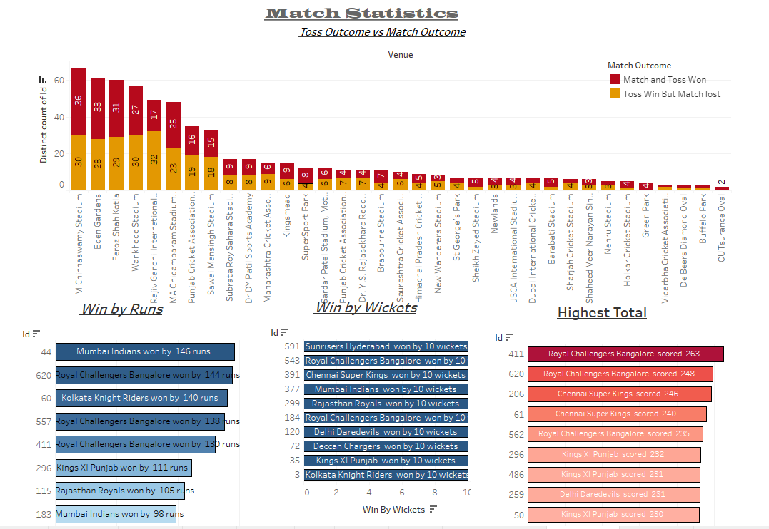
Match Statistics

Slide 4
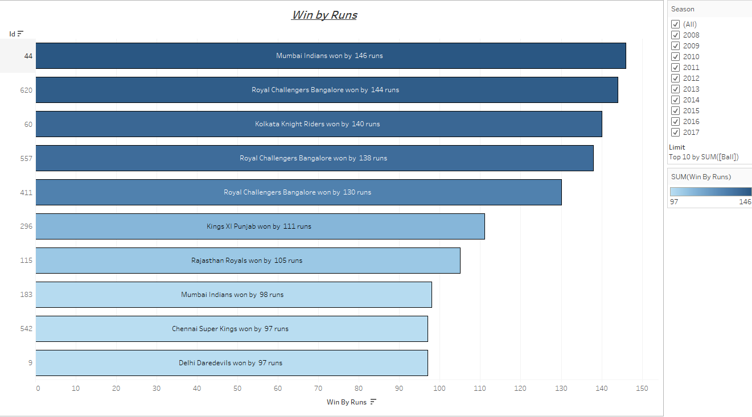
Win By Runs
From the Above Figure, we can State that Mumbai Indians is the only Franchise among others ,which has won by the highest RUNS of 146 among all the seasons.

Slide 5
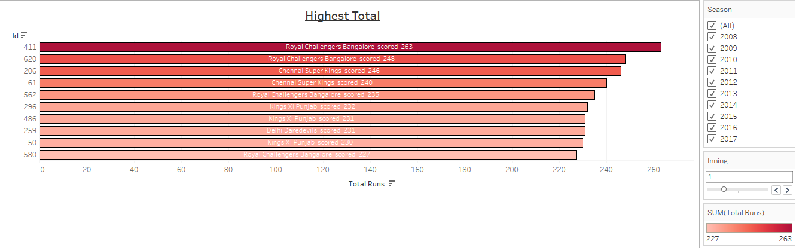
Highest Total
Royal Challengers Bangalore is the only team which has set the highest total among other teams twice across various seasons.

Slide 6
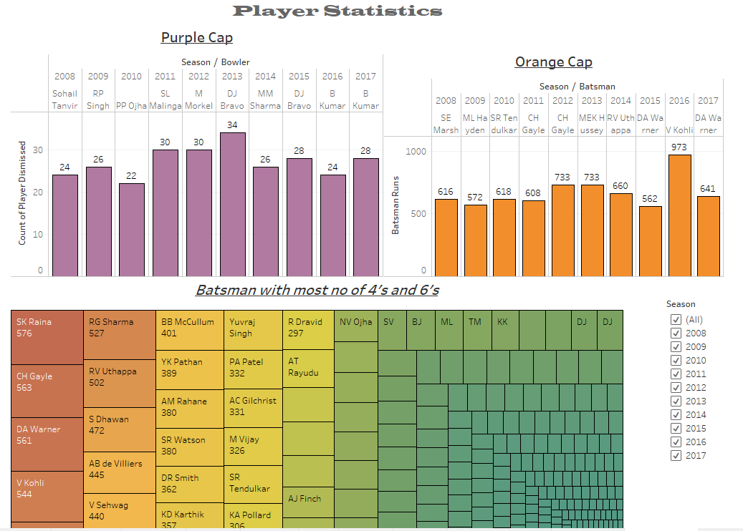
Player Statistics

Slide 7
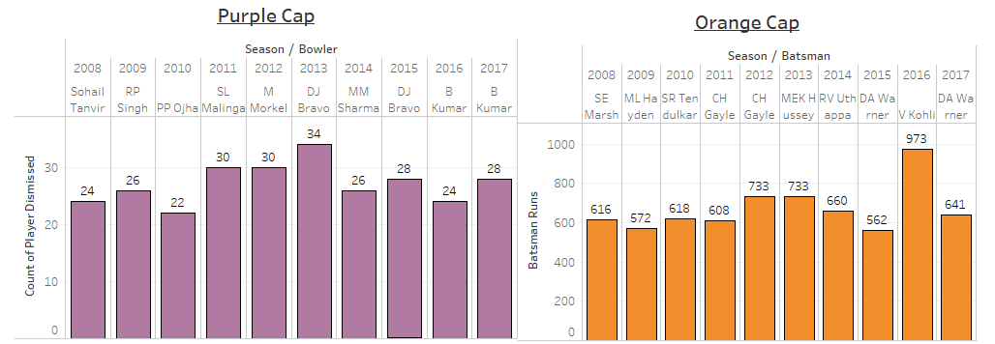
Hall of Fame
From GRAPH 1, we can see that purple cap holder DJ Bravo of CHENNAI SUPER KINGS has dismissed most number of batsman during the year 2013 among all the seasons.
FROM GRAPH 2, we can see that Orange cap holder Virat kohli has scored maximum runs of 973 during 2016.

Slide 8
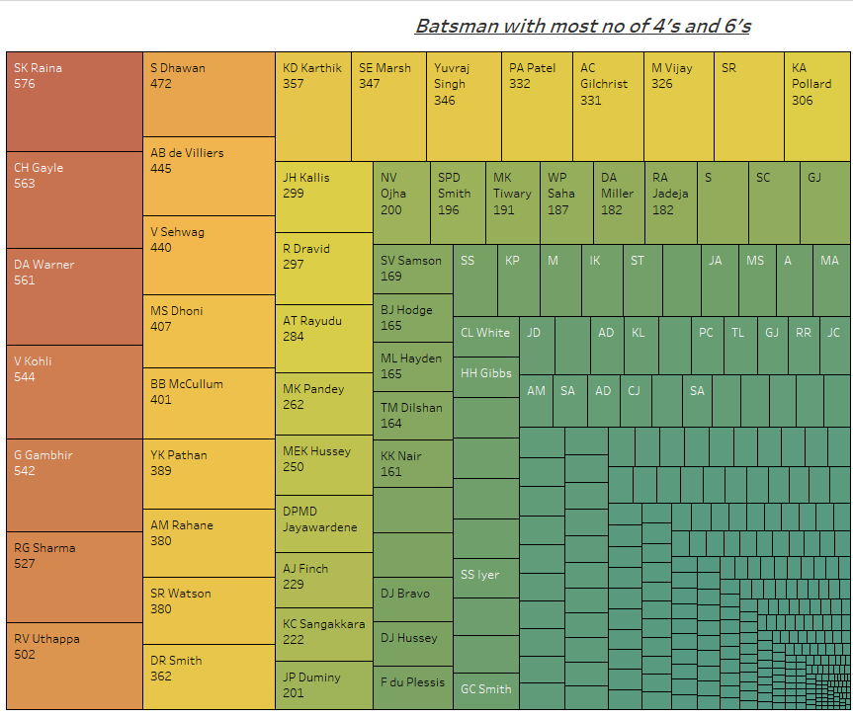
Most number of boundaries scored
Across all the seasons, Suresh Raina has hit most number of 4’s and 6’s followed by ch gayle and david warner.

Slide 9
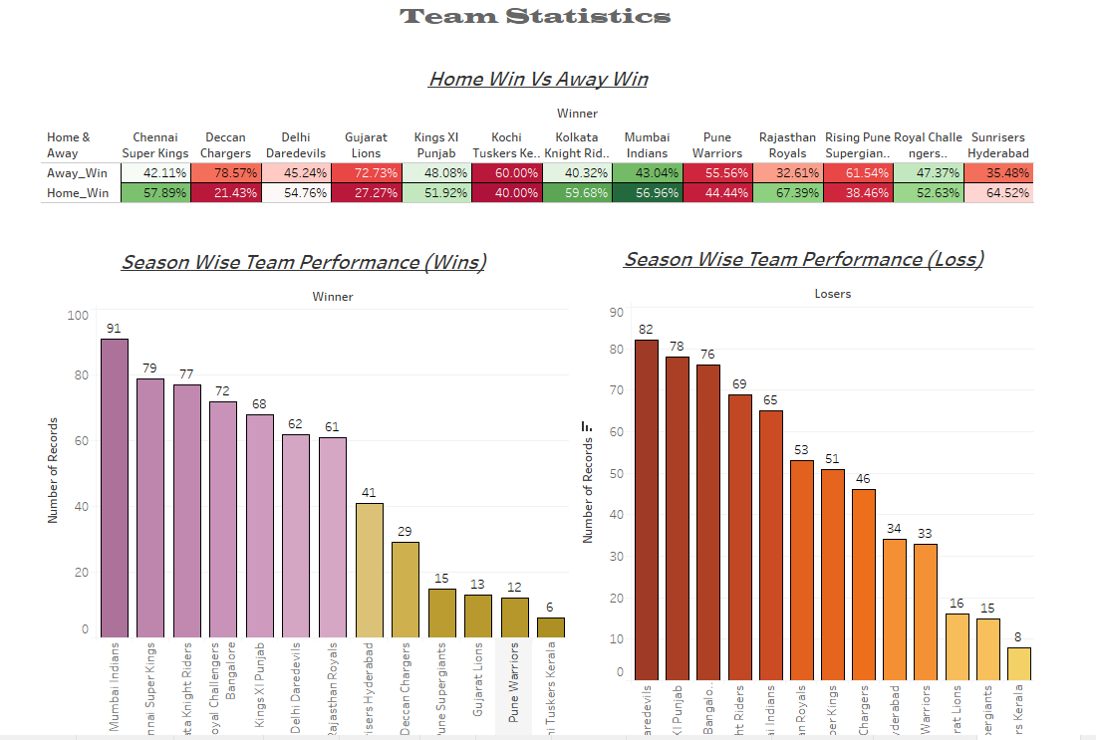
Team Statistics

Slide 10
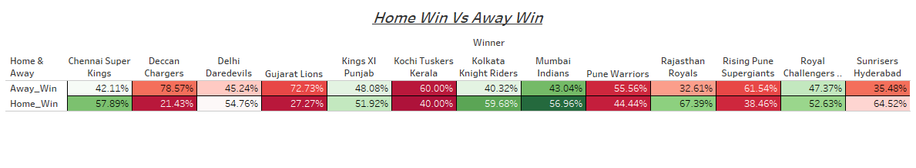
Home Vs Away Win Statistics
The above graph gives the clear idea of win comparison of teams between home and away conditions.
Rajasthan royal is the most successful team with a win% of 67.39 in the home condition.
Deccan chargers is the most successful team with a win% of 78.57 in the away condition.

